Slide 1


Synopsys.ai: AI-Driven EDA
Synopsys.ai is an advanced suite of AI-driven solutions that optimize silicon performance, accelerate chip design, and improve efficiency throughout the entire EDA flow.
by 峰 喬

Slide 2

Unleash the Power of Synopsys.ai
1
Optimize Silicon Performance
Synopsys.ai helps you achieve unbeatable PPA results, the fastest time to targets, and next-level productivity.
2
Accelerate Chip Design
Synopsys.ai enables design teams to scale and operate at expert levels, revealing untapped insights from vast amounts of EDA tool data.
3
Improve Efficiency
Synopsys.ai provides instant guidance with conversation intelligence and automated creation of workflows, RTL, and testbenches with GenAI.

Slide 3
What's New
Synopsys.ai Copilot
Bringing Generative AI to Semiconductor and Electronics Design
Market Leaders Collaborate with Synopsys
Breakthrough GenAI capability to accelerate chip design. Read More →
Realize the gains of Generative AI across the Synopsys.ai full EDA stack. Read More →
Learn more about how GenAI is changing the chip design landscape. Read More →
Read More →
Read More →
Read More →

Slide 4


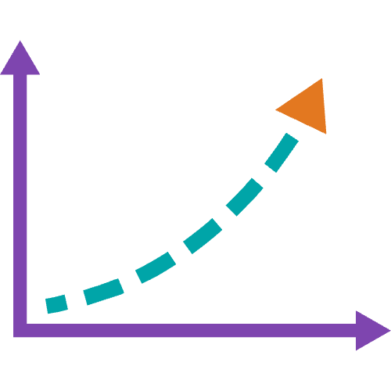
Key Benefits
Unbeatable PPA Results
Fastest Time to Targets
Next-Level Productivity
Explore a larger scale of choices in chip design workflows.
Autonomously converge to tapeout-ready solutions.
Enable design teams to scale and operate at expert levels.

Slide 5

Full-Stack AI-Driven EDA Solutions
GenAI
Comprehensive GenAI capabilities across the entire EDA stack.
Optimized Design & Verification
Full-stack AI-driven EDA solutions for chip design and verification.
Data Analytics
Full-scale data analytics from chip design to manufacturing.

Slide 6

GenAI
Synopsys.ai is the first electronic design automation suite to harness the power of generative AI across the full EDA stack.

Slide 7
Optimized Design & Verification
Design
Verification
Test
Search for optimization targets in very large solution space of chip design by using AI engines to enhance power, performance, area, and maximize QoR.
Achieve higher coverage quality faster so that bugs don’t go undetected and eliminates redundancies in regressions and automates root cause analysis.
Optimize test program generation in complex designs to achieve maximum defect coverage with fewer test patterns.

Slide 8
Data Analytics
Design & Verification
Process Control
Production
Synopsys Fab.da provides a scalable data platform to store and analyze large streams of fab equipment process control data. AI/ML pipelines process this data to create insights and rapid analysis of manufacturing data for accurate diagnosis of yield issues.
Synopsys Silicon.da leverages petabytes of silicon monitor, diagnostic and production test data from test equipment to quickly determine how to improve key chip production metrics, while also improving key silicon operational metrics.
Synopsys Design.da performs deep analysis of data from Synopsys.ai design execution to provide chip designers with comprehensive visibility and new insights and anomalies on PPA trajectories and specific opportunities for improving designs.

Slide 9

Resources
1
Article
SemiWiki: Synopsys.ai Ups the AI Ante with Copilot. Read More →
Read More →
2
Media
Forbes: Tech Leaders Collaborate On Generative AI For Accelerated Chip Design. Read More →
Read More →
3
Podcast
Six Five Podcast: Synopsys.ai Copilot. Learn More →
Learn More →
4
Webinar
Unleashing the Power of AI in EDA for Chip Design. Watch Now →
Watch Now →

Slide 10

Elevate Your Chip Design and Development with AI
Get Started Today. Contact Us.
Get Started Today

Slide 11
🙋 Q & A

